Slide 1
YouTube Data Trend & Activity Analysis Project
Project Overview
Group Name: YT TrendTrackers
Group Members: Suhail, Laxmi & Deelip
Objective: Analyze YouTube trending data to understand content performance, video trend, relation between views & likes & comment, audience engagement and Creator activity.
Dataset: 3 Publish Countries | 37K Videos | 6K Channels | 3.57 Trillion Views | 95B Likes | 2.24B Comments | 120 Trending Countries | 15 Videos Category | Video Publish Date | Video Trending Date | Channel Publish date | Channel Subscriber Count | Channel View & Like Count ETC.
Time Period: Oct-2024 To Dec-2025.
Tools: Python(For Data Cleaning & ETL Process).
SQL Server(To Perform Exploratory Data Analysis).
Power BI(To Perform Dax Queries & For Doing Visualization).

Slide 2
Key Metrics Summary
MATRICS | VALUES
Total Videos | 37K
Total Channels | 6K
Total Views | 3.57 Trillion
Total Likes | 95 Billion
Total Comment | 2.24 Billion
Avg View Per Video | 95.43 Million
Avg Like Per Video | 2.54 Million
Avg Comment Per Video | 59.67k
Avg Num of Videos Per Channel | 6

Slide 3

Data Problems Identified
While extracting a large dataset into Python, I encountered several issues, including multiple errors due to the absence of a unique identifier column. Many categorical columns such as video id and channel id contained duplicate and inconsistent values, while numerical columns like view count and like count had repeated entries. Additionally, there were several data type mismatches, especially in date-related columns like video duration column was stored as text, which caused parsing errors. To resolve these problems, I identified and handled distinct values for key categorical fields, removed duplicates from numerical columns, standardized and converted all date columns into proper date/time formats, and transformed the video duration field into a suitable time format. After these corrections, the dataset became clean, consistent, and ready for analysis in Python.

Slide 4
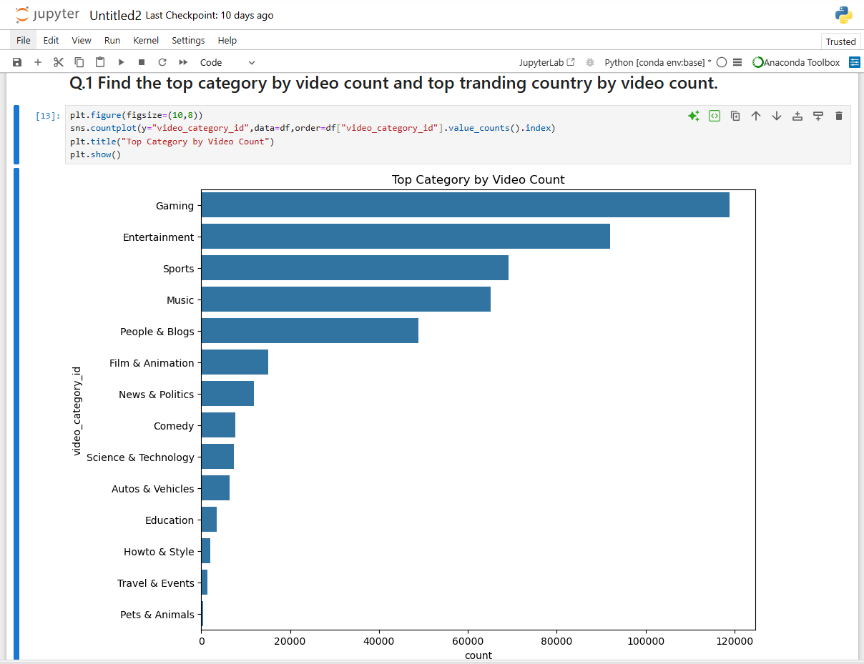
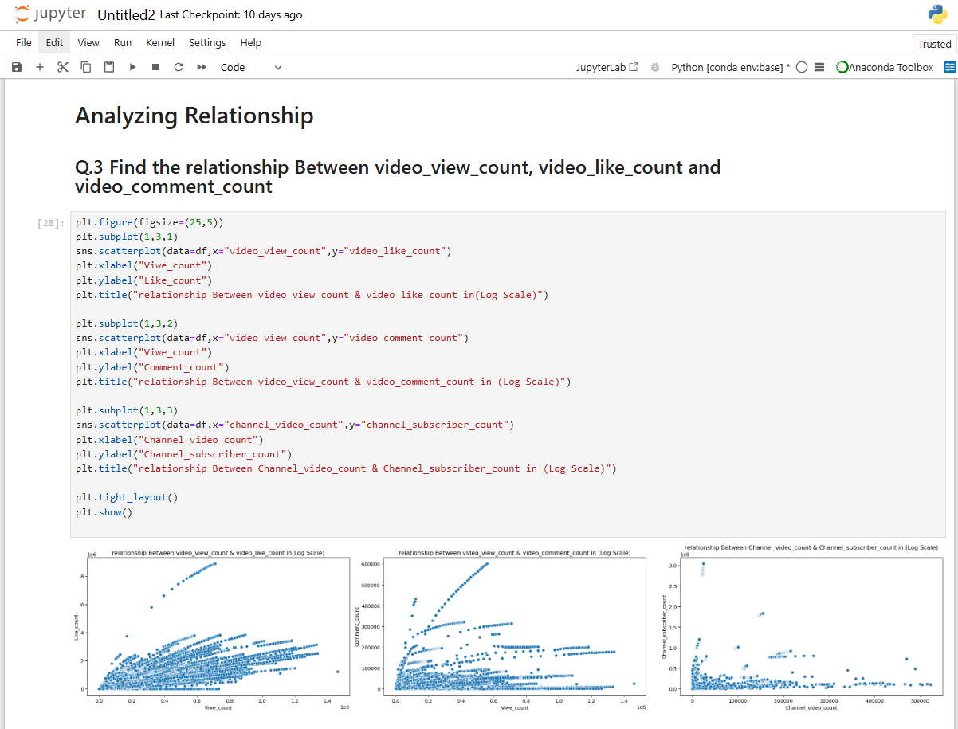
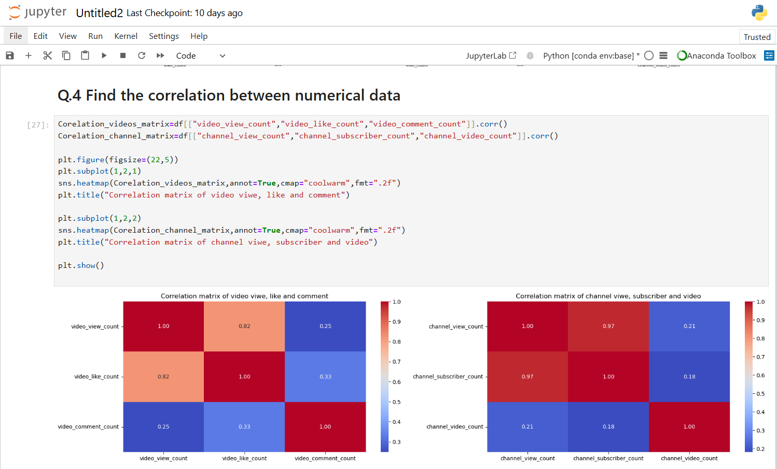
Eexploratory Data Analysis
I performed Exploratory Data Analysis (EDA) on the YouTube Trending dataset using Python. The analysis focused on identifying the top video categories based on the number of trending videos and determining the countries where videos trend the most. Additionally, I examined the relationships between key engagement metrics such as views, likes, and comments, and calculated the correlation between numerical variables to understand how they influence each other.

Slide 5
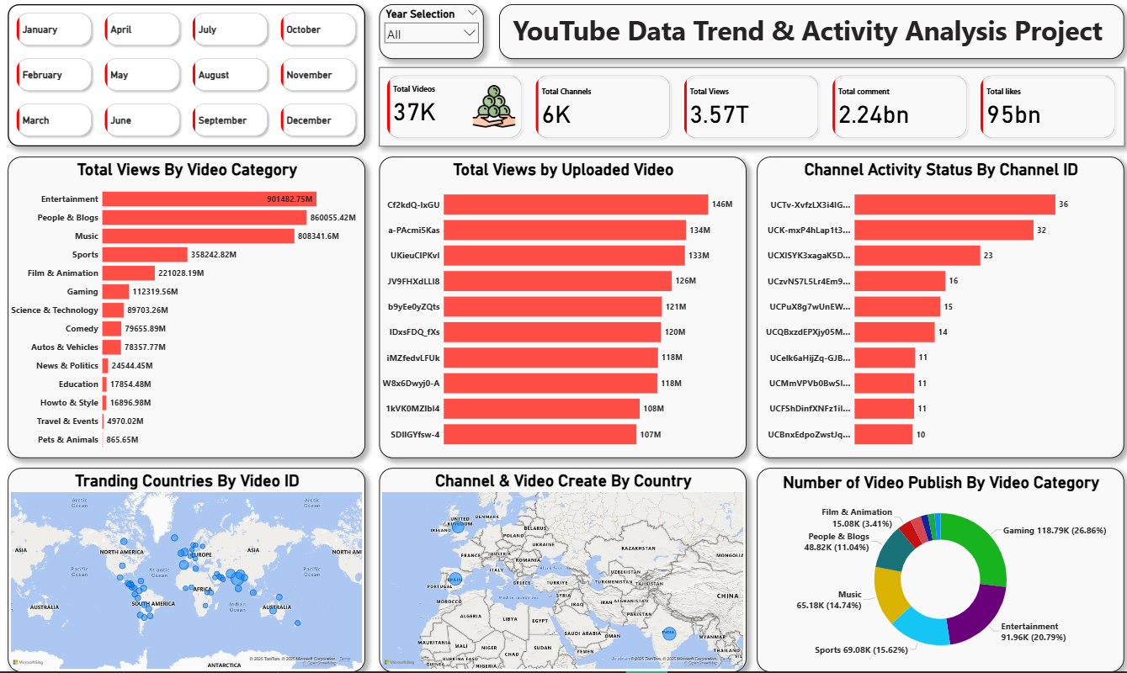
Insights by Category
• Top Performing: Entertainment (901B), People & Blogs (860B), Music (808B).
• More then 50% of total views gain only these three categories.
• Lowest Performing: Travel & Events, Pets & Animals.
• Top video reached 146M views.
• Most active channel: 36 trending videos.
• Top 3 countries in descending order: India, Spain, UK.
• Top Trending Region: India achieve a highest num of videos trend in country and Most of the video’s trend in Asia's Indian subcontinent region.
• Lowest Trending Region: The African region recorded the lowest number of trending videos on YouTube.

Slide 6
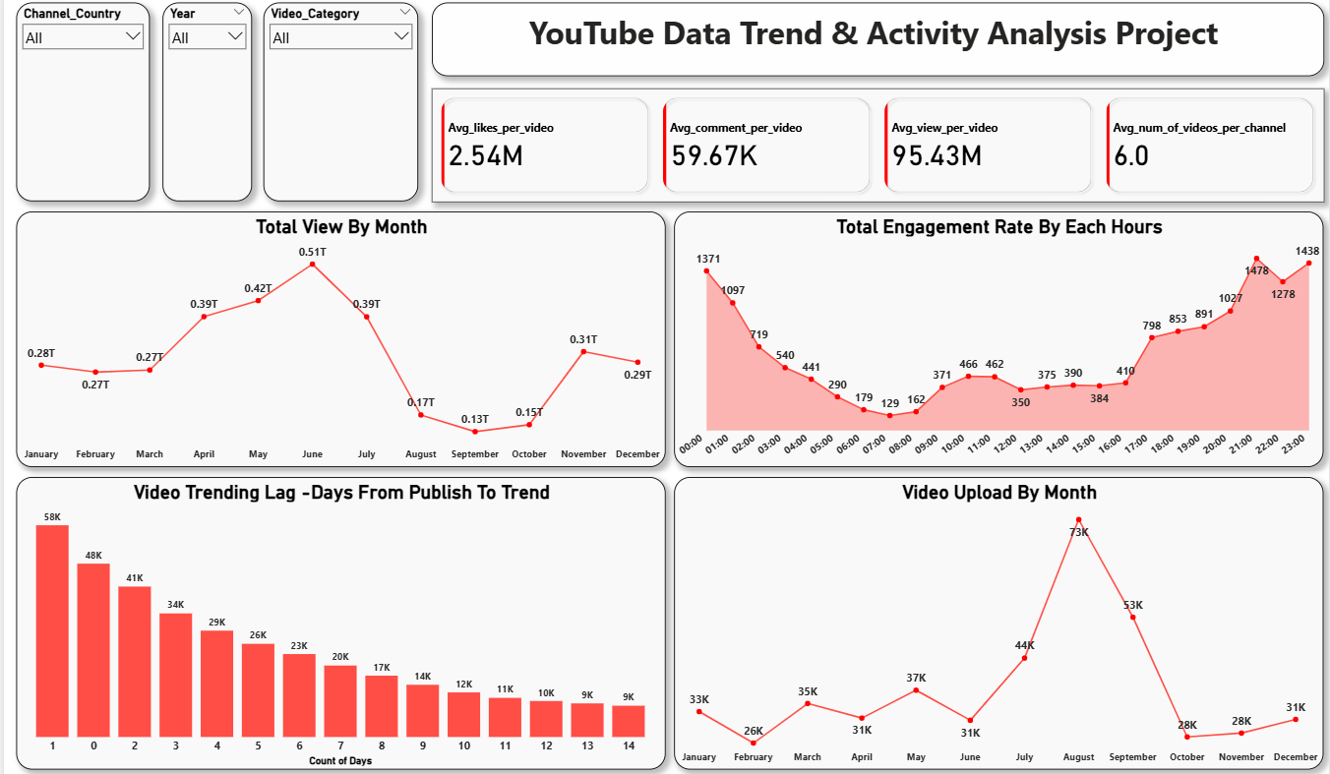
Time Series Insights
• Steady monthly view growth and June recorded the highest num of views and September month recorded the lowest num of views.
• Peak engagement Hour: 8 P.M. To 1 A.M.
• Video trend Leg: 58k means large num of videos trend only one day but some videos trend 14 days and above that’s show the good consistency.
• Uploading Status: The months from July to September recorded the highest number of video uploads, while the other months showed a nearly similar number of uploads.

Slide 7
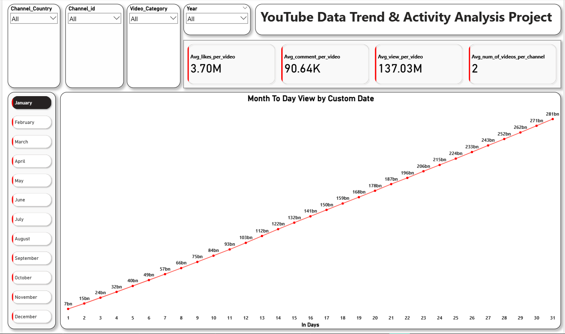
Day To Day Views Insights
The "Date to Day View Analysis" reveals an exceptional performance profile driven by consistent, compounding viewership and market-leading engagement across the analyzed channels. The views demonstrate a robust, near-perfect linear growth trend, climbing from an initial 7 Billion to a staggering 2.88 Trillion total views over 31 days. This sustained daily accumulation is supported by best-in-class per-video performance, specifically an Avg. of 137 Million views and 3.7 Million likes per video. This combination proves the selected content has successfully cultivated strong audience loyalty and daily viewing habits, making the underlying strategy highly scalable and a powerful benchmark for maximizing reach and community interaction.
YT Trend Trackers

Slide 8
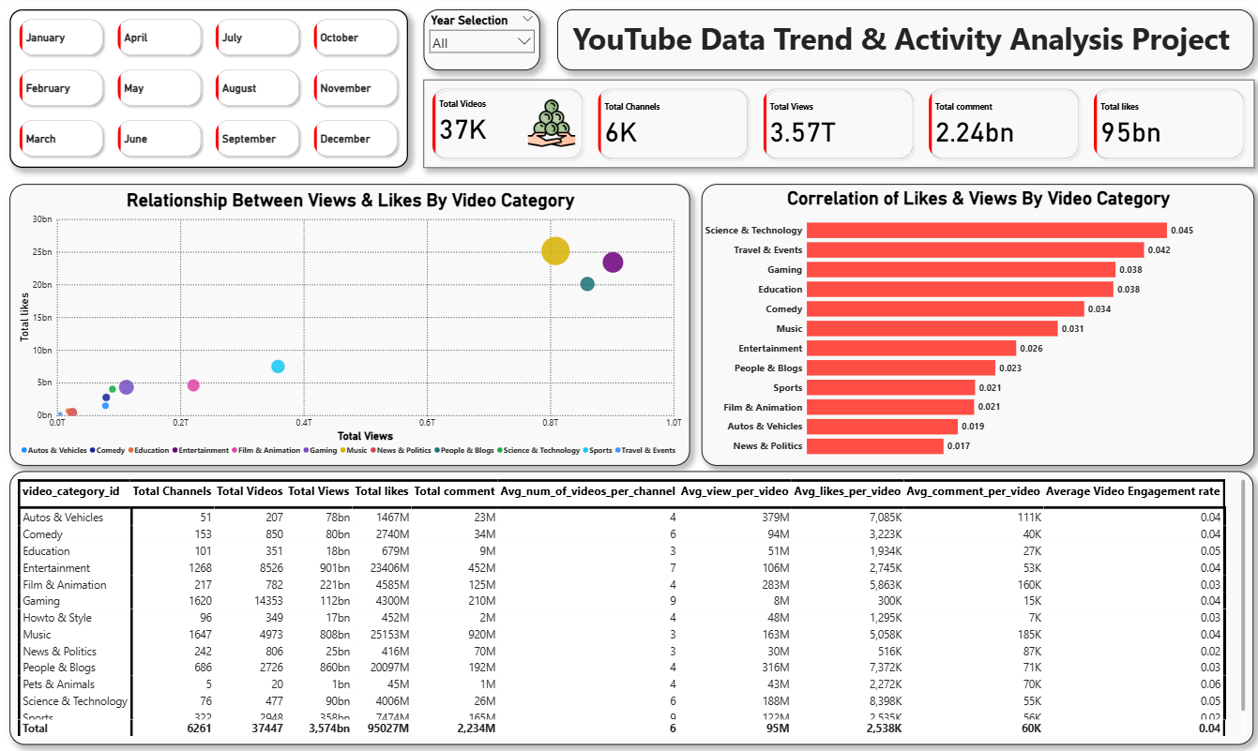
Correlation & Relationship Insights
• Strong relationship between Views & Likes and Music category show the highest relationship and Autos & Vehicles show poor relationship.
• Science & Tech, Gaming show highest correlations and Autos & Vehicles and News & politics show the lowest correlation.
• At last show the total categorical performs across the all Numerical and matrix columns.
YT Trend Trackers

Slide 9
Key Takeaways Insight
• The Entertainment category dominates the “Total Views by Category” chart. However, in terms of the correlation between views and likes, it records relatively low engagement, indicating that high visibility does not necessarily translate to stronger audience interaction.
• Science & Technology and Pets & Animals categories have lower total views but exhibit a high correlation between views and engagement metrics (likes and comments). This suggests that smaller categories attract more loyal and active audiences.
• India has emerged as the largest YouTube market, with the highest number of trending videos and content creators. This highlights India’s massive user base and creator community driving platform activity.
• The time period between 8 PM and 1 AM shows the highest user activity on YouTube, making it the optimal time for advertisements and promotional campaigns.
• There is an inverse relationship between the total views recorded each month and the number of videos uploaded—indicating that more uploads do not always guarantee higher overall viewership.
YT Trend Trackers

Slide 10
Recommendations
• Focus on high-engagement categories (Science & Technology, Gaming, Education and Pets & Animals).
• Maintain consistent upload schedule for growth.
• Leverage regional audience patterns to target specific audiences.
• Use data-driven KPIs to monitor and improve channel performance and track channel consistency regularly.
Try to upload videos during peak and active hours to grab maximum user attention and views.
YT Trend Trackers
Thanks for giving your valuable time

